Slide 1
Introduction to Apache Spark Lightening fast cluster computing

Slide 2
Agenda ● Evolution of distributed systems ● Need of new generation distributed system ● Hardware/software evolution in last decade ● Apache Spark ● Why Spark? ● Who are using Spark?

Slide 3
Apache Spark ● Cluster computing framework ● Fault tolerent ● A fast and general engine for large scale data processing ● Created by AMPLab now Databricks ● Written in Scala ● Licensed under Apache ● Lives in Github

Slide 4
Why Spark?

Slide 5
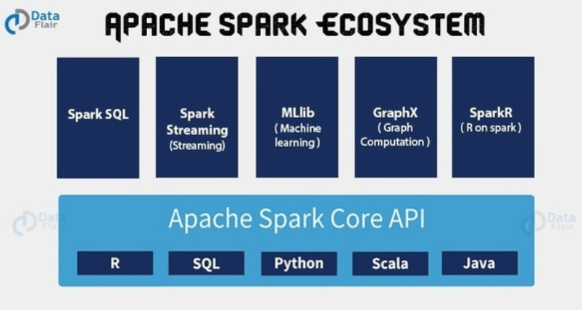
Spark Core

Slide 6
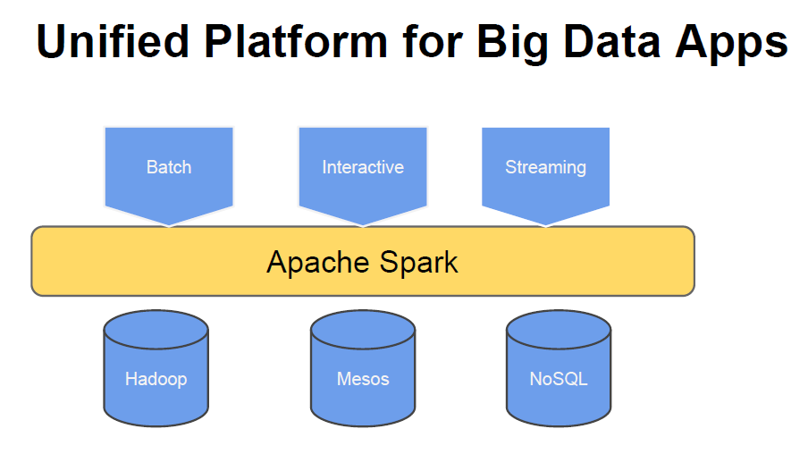
Spark Core

Slide 7
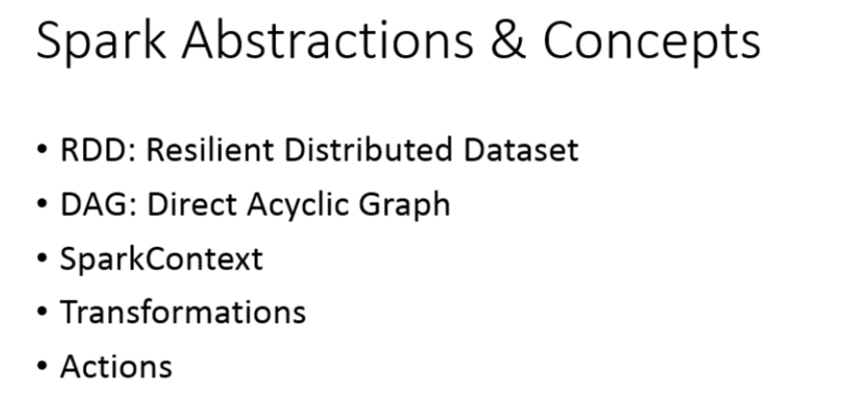

Slide 8
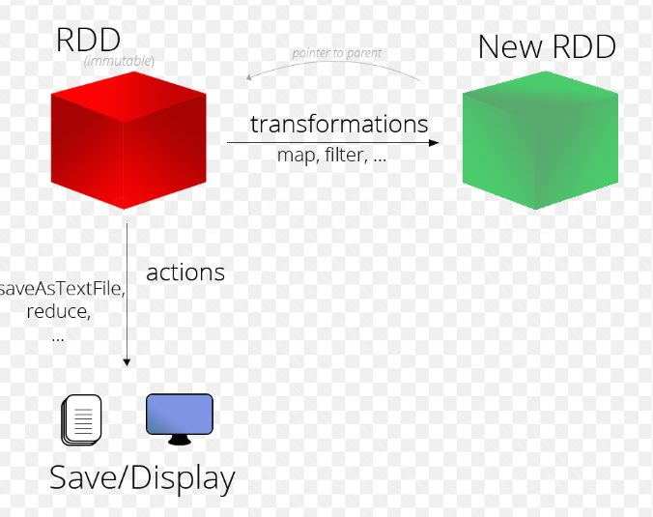
RDD
The foundation data structure of Spark is RDD, which is fault-tolerant collection of elements.
RDD can be created in two ways
Parellelizing an existing collection
Referencing a data set from the external storage

Slide 9
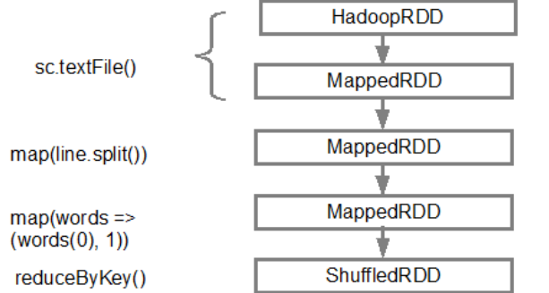
DAG - Directed Acyclic Graph
DAG is the graph denoting the sequence of operations that are being performed on the targe RDD.

Slide 10
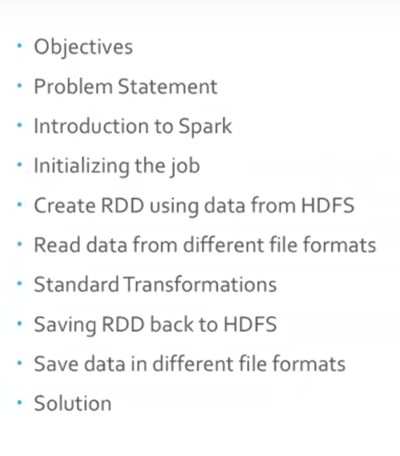
Objectives

Slide 11
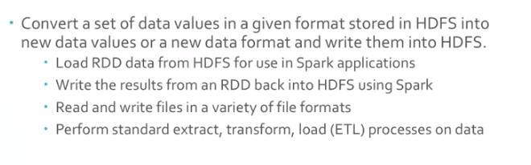
Problem Statement

Slide 12
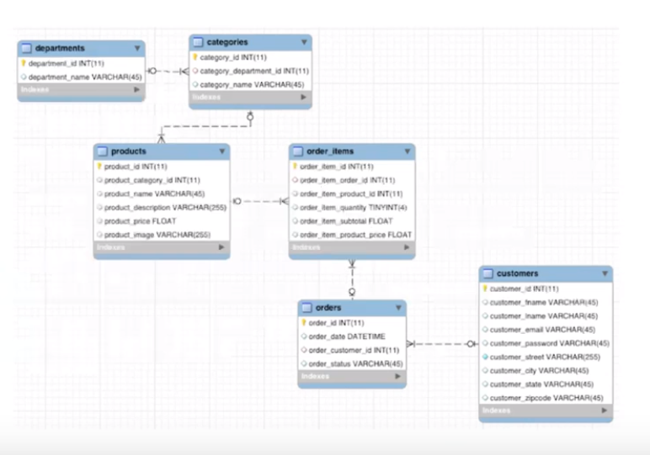
Data Model

